Slide 1
Hospital Infection Control

Slide 2
Principles of Infection Control and Prevention
The basic goal of an Infection Prevention & Control Program is to prevent the spread of infection and to eliminate the spread of microorganisms from one person to another.
Patients frequently acquire infections while hospitalized. These are referred to as nosocomial or hospital acquired infections.
Hospital personnel seldom acquire infections from patients. The main reason that patients, rather than staff, are more susceptible to infection is that the patient's general state of health and ability to fight infection is very low.
In addition, many patients undergo invasive procedures which can allow entry of bacteria into the body.

Slide 3
Standard Precautions
Standard precautions are designed to reduce the risk of transmission of microorganisms from both recognized and unrecognized sources of infection in hospitals.
Standard Precautions apply to ALL patients receiving care in hospitals, regardless of their diagnosis or presumed infection status.
Standard Precautions apply to:
Blood
All body fluids, secretions, and excretions except sweat, regardless of whether or not they contain visible blood
Non-intact skin
Mucous membranes.
Standard Precautions are fundamental to patient care and are the standards of practice by every healthcare worker

Slide 4
Stopping the Spread of Infections
Microorganisms are spread primarily three ways within a hospital setting:
Contact: direct contact via body surface-to-body surface contact, or indirect contact via contaminated articles,
Droplet,
Droplet plus
Airborne
Each of these methods of transmission can frequently be eliminated with simple precautionary measures, including the use of proper personal protective equipment (PPE)

Slide 5
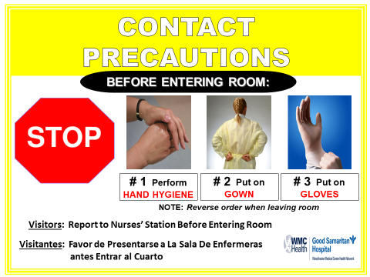
Contact Precautions
Organisms can be spread by direct contact with infected or colonized patient or indirectly with contaminated objects (fomites).

Slide 6
Contact Precautions
Used for communicable infections spread by direct or indirect contact, for example Multi-Drug Resistant Organisms (MDRO)
Private room preferred
Gowns and gloves must be worn when entering the room
Perform hand hygiene upon entering the room before donning PPE, when leaving the room after doffing PPE and when moving from a dirty area of the body to a clean area
Patients on Contact Precautions may be cohorted after consultation with the Infection Prevention & Control team

Slide 7
Contact Precautions
Contact Precautions for organisms that are spore forming, highly pathogenic/ drug resistant or especially hearty sometimes require
Soap and water hand hygiene
Use of bleach for low level disinfection.

Slide 8
Droplet Precautions
Transmission occurs when droplets containing microorganisms from the infected person are propelled a short distance through the air and deposited on the susceptible hosts conjunctivae, nasal mucosa, or mouth.

Slide 9
Extended Droplet Precautions
This is used for Covid -19 (+) and Rule Out Covid -19

Slide 10
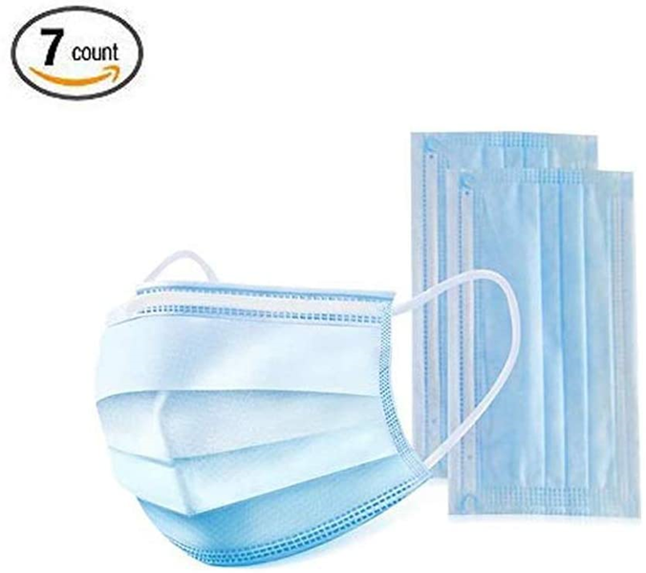
Droplet Precautions
Droplets are generated from the source person primarily during coughing, sneezing, talking, and during the performance of certain procedures, such as suctioning and bronchoscopy.
The droplets do not remain suspended in the air; therefore, special air handling and ventilation are not required.

Slide 11
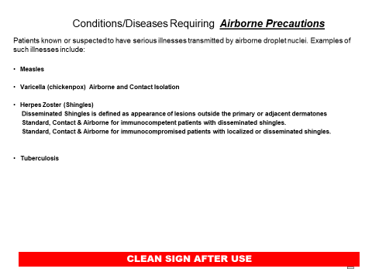
Airborne Precautions
Airborne transmission occurs by dissemination of either airborne droplet nuclei (small particle residue that is 5μ or smaller in size) containing microorganisms that remain suspended in the air for long periods of time.

Slide 12
Airborne Precautions
Microorganisms carried in this manner can be widely dispersed by air currents and may become inhaled by a susceptible host within the same room or over a longer distance from the source patient, depending on environmental factors. Special air handling and ventilation (such as a negative air pressure room) are required to prevent airborne transmission.
Private room with negative air pressure

Slide 13
Respiratory Etiquette
The elements of Respiratory Hygiene/Cough Etiquette
Includes: Education of healthcare facility staff, patients, and:
Posted signs in language appropriate to the population served with instructions to patients and accompanying family members or friends.
Source control measures (e.g. covering mouth/nose with a tissue when coughing and disposing of used tissues, using surgical masks on the coughing person when tolerated and appropriate).
Hand hygiene after contact with respiratory secretions.
Spatial separation, ideally >3 feet, of persons with respiratory infections in common waiting areas when possible.

Slide 14
Respiratory Etiquette
Do not report for work if you are ill, especially if you are coughing
Cover your nose and mouth when you sneeze or cough
Cough and sneeze into a tissue and throw it away in the nearest waste basket
If you do not have a tissue, cough or sneeze into your upper sleeve, not your hand
After coughing or sneezing, clean your hands with soap and water or alcohol hand rub
Do not share eating utensils, drinking cups, water bottles, towels or other personal items including lip balm, lipstick, toothbrushes etc.
In waiting areas for patients and visitors provide:
Tissues and no-touch waste basket for used tissue disposal
Conveniently located alcohol-based hand rub; where sinks are available, ensure that supplies for hand washing are consistently available.

Slide 15
Blood borne Pathogens
Health care workers have a higher risk for blood borne pathogen exposure. The three most commonly exposed viruses are Hepatitis B virus (HBV), hepatitis C (HCV), and human immunodeficiency virus (HIV) in health care setting. Avoiding occupational blood exposures is the primary way to prevent transmission of HBV, HCV, and HIV in health care settings.
These pathogens are also found in other body fluids such as:
Blood products
Semen
Vaginal secretions
Fluid in the uterus of a pregnant women
Fluids surrounding the brain, spine, heart and joints
Fluids in the chest and abdomen.

Slide 16
Blood borne Pathogens
Risk to Personnel
You may be exposed to bloodborne pathogens in the healthcare setting by a variety of means:
Needles and other sharps
Contact to mucous membranes: eye, mouth, nose
Non-intact skin: open cuts, nicks, chapped, skin abrasions, or afflicted with dermatitis
Specific measures that are instituted to minimize or eliminate the risk of healthcare workers (HCW) occupational exposure include:
adherence to Standard Precautions (e.g. washing hands after patient contact),
adherence to engineering controls such as needle-less systems and needle/sharp safety device.
safe work practices (e.g. safe disposal of needles and use of scalpels)

Slide 17
Management of Blood/Body fluid Spills
What to do:
Put on gloves and wipe area clean with disposable towels
Disinfect area with the hospital approved disinfectant
Place used towels in plastic-lined trash container
Place any articles that are saturated with blood or body fluids into RED plastic lined trash container
Remove gloves and wash hands.
NOTE: DO NOT PICK UP BROKEN GLASS DIRECTLY WITH YOUR HANDS; instead, pick up with mechanical means such as a brush and dustpan, tongs, or forceps

Slide 18
Hand Hygiene
Hand washing is the single most important measure in preventing the spread of infection
Before:
Starting your work day
Before Patient contact
Eating
Donning PPE
After:
After Contact with a Patient or their environment
Removing gloves
Using the restroom

Slide 19
Information taken form Centers for Disease Control and Prevention
Please consult www.cdc.org for most up to date information and guidelines.

